Slide 1
Module 1 - Networking Today
© Tage Bushman

Slide 2

Agenda
What is a Network?
Network Components
Network Representations and Topologies
Common Types of Networks
Reliable Networks
Network Security - CIA Triad
Network Trends
Security Threats

Slide 3
What is a Network?
A network is a group of two or more devices (like computers, smartphones, or printers) that are connected to share information and resources, such as files, data, or internet access.
These devices use communication methods, like cables or wireless signals, to exchange data and communicate with each other.
In simple terms, a network allows different devices to talk to one another and work together, making it easier for users to access shared resources and information.

Slide 4
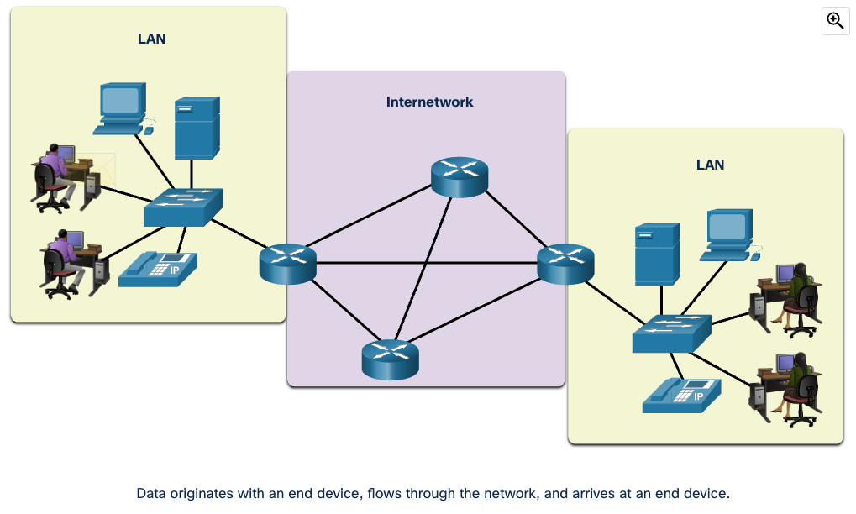
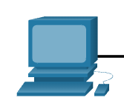
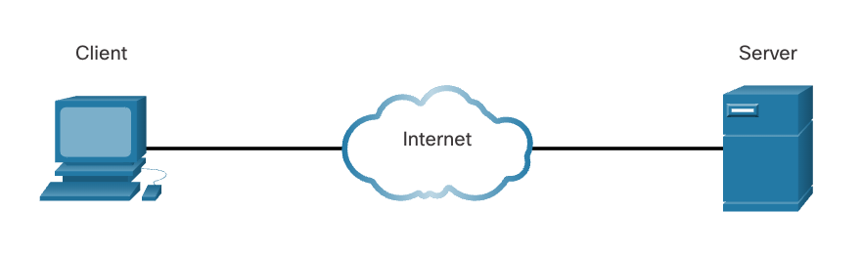
Network Components
What is a host?
  Any device that connects to a network and can send and receive information
Host Roles
  Client
  Server
End Device
Intermediary Device

Slide 5
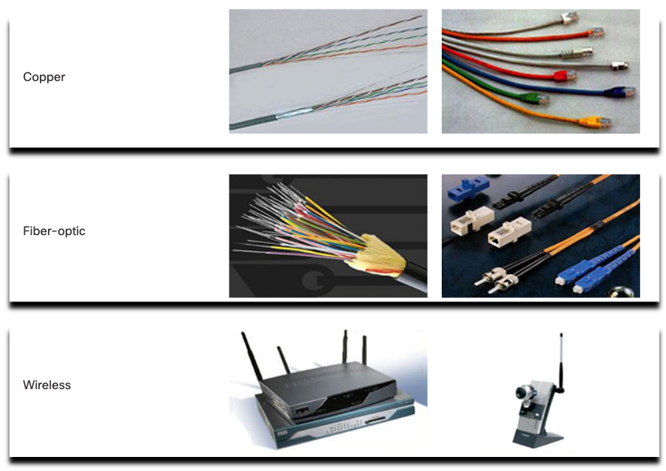
Network Media

Slide 6
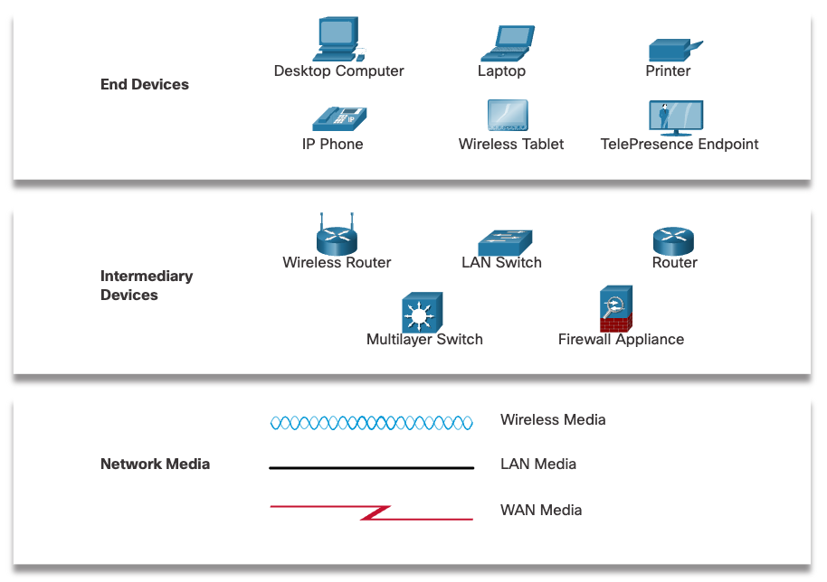
Network Representations and Topologies

Slide 7
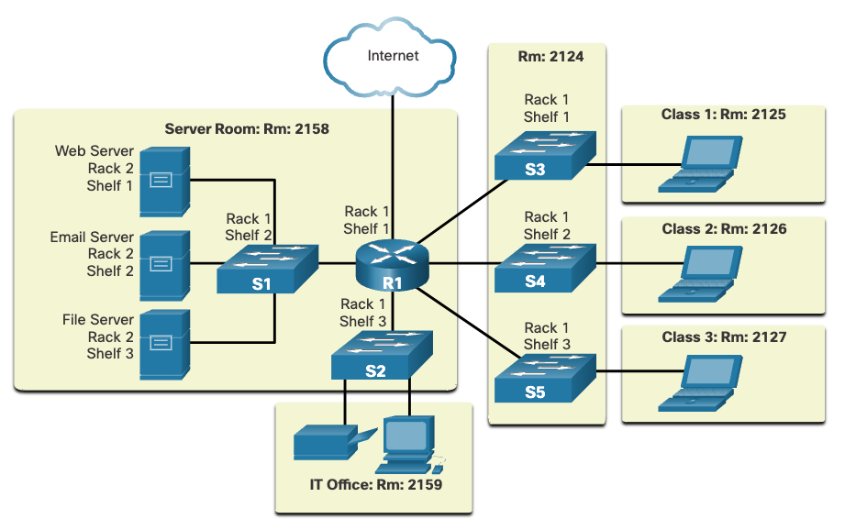
Physical Topologies

Slide 8
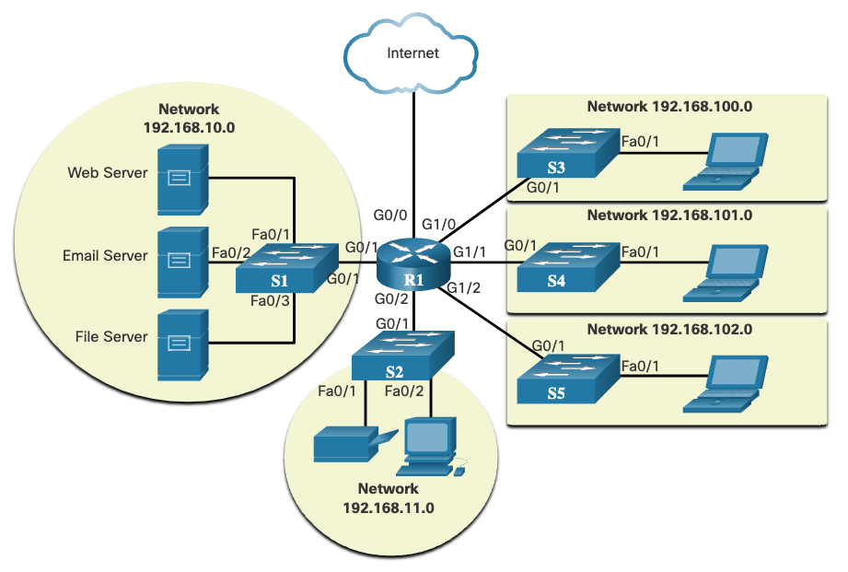
Logical Topologies

Slide 9
Types of Networks
Small Home Networks | Connect a few computers to each other and to the internet
Small Office and Home Office Networks (SOHO) | Allows computers in a home office or a remote office to connect to a corporate network, or access centralized, shared resources
Medium to Large Networks | Can have many locations with hundreds or thousands of interconnected hosts
World Wide Networks | The internet is a network of networks that connects hundreds of millions of computers world-wide

Slide 10
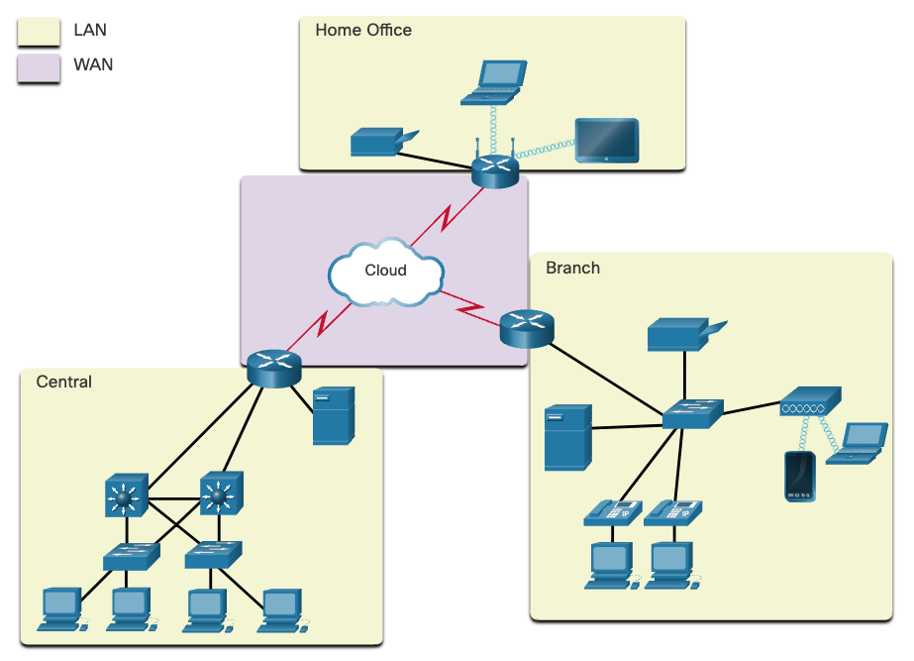
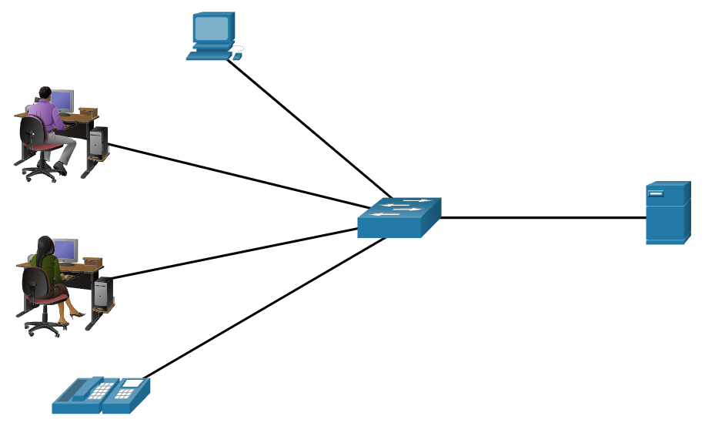
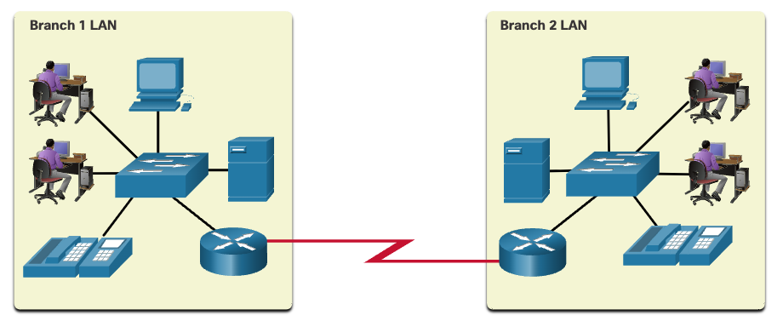
LANs and WANs

Slide 11
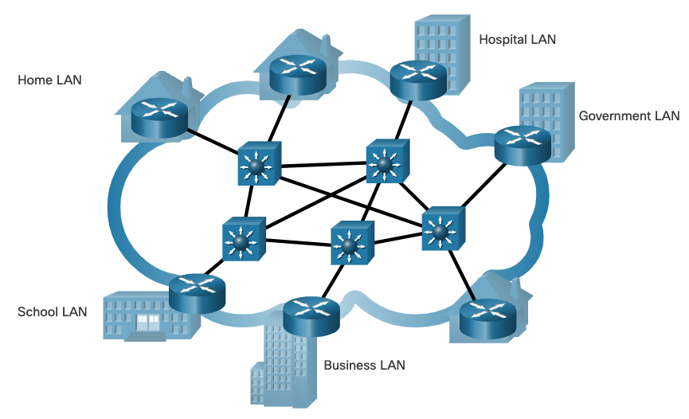
The Internet

Slide 12
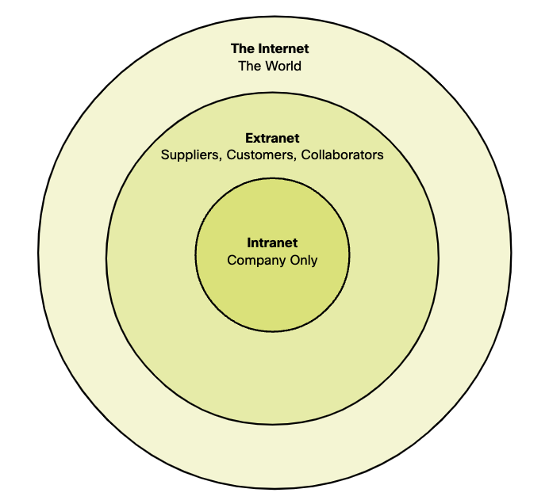
Intranets and Extranets

Slide 13
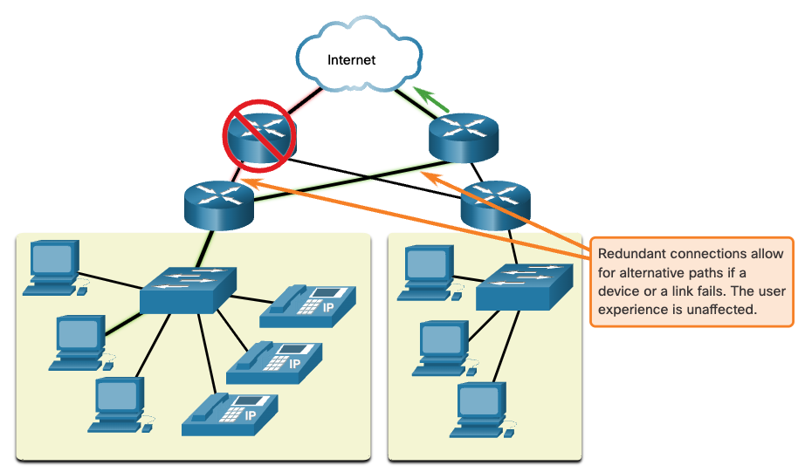
Fault Tolerance

Slide 14
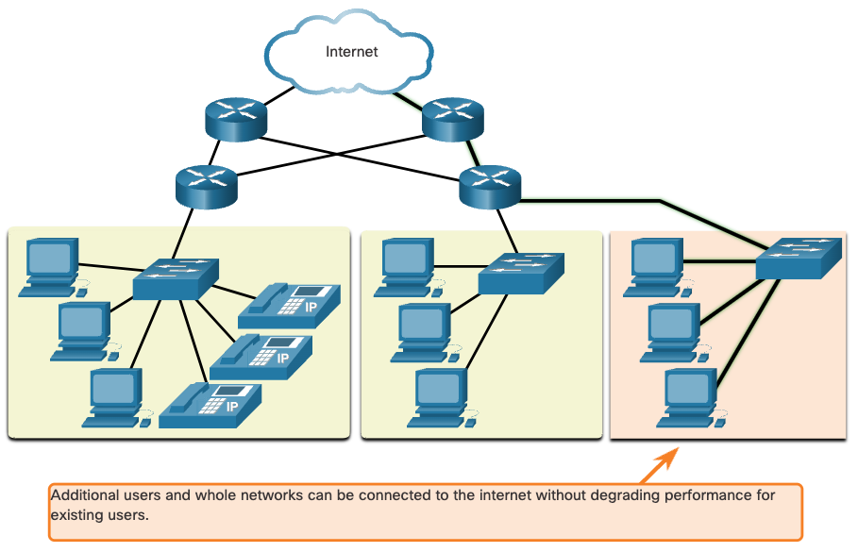
Scalability

Slide 15
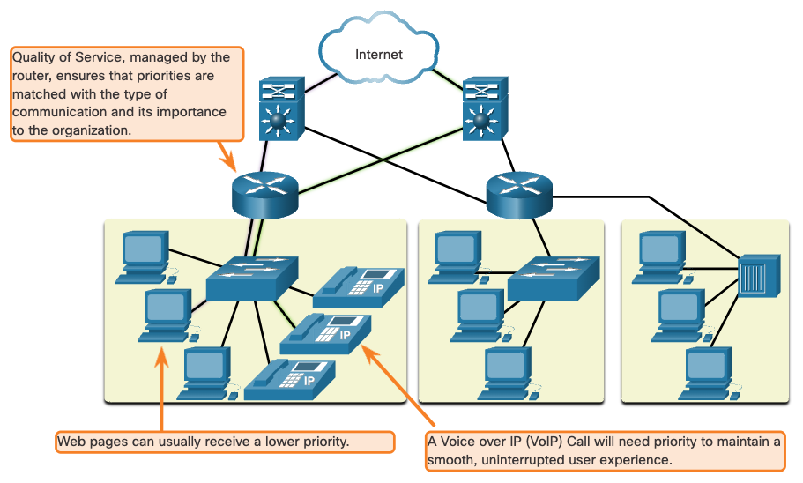
Quality of Service

Slide 16
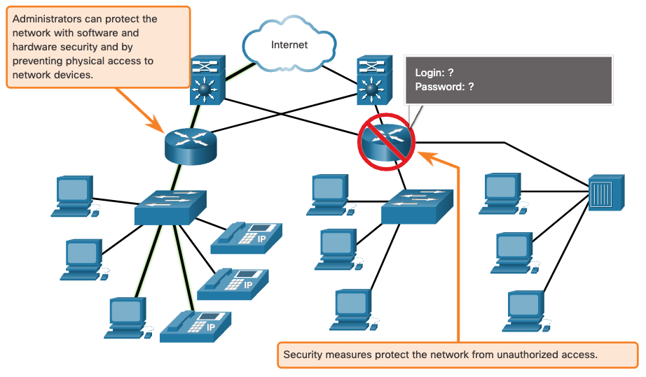
Network Security

Slide 17
CIA Triad
Confidentiality | Only the intended and authorized recipients can access and read data
Integrity | Information has not been altered in transmission, from origin to destination
Availability | Timely and reliable access to data services for authorized users

Slide 18
Network Trends
Bring Your Own Device (BYOD)
  Laptops
  Cell Phones
Online Collaboration
  Zoom
  Teams
  Office 365
  Google Docs

Slide 19
Network Trends (cont.)
Cloud Computing
  Amazon Web Services (AWS)
  Microsoft Azure
Technology in the Home
  Smart Home
  Apps

Slide 20
Security Threats
Viruses, Worms, and Trojan Horses | Malicious software or code running on a user device
Spyware and Adware | Types of software which are installed on a user’s device. The software then secretly collects information about the user
Zero-day Attacks | Also called zero-hour attacks, these occur on the first day that a vulnerability becomes known
Threat Actor Attacks | A malicious person attacks user devices or network resources
Denial of Service Attacks | Slow or crash applications and processes on a network device
Data Interception and Theft | Captures private information from an organization’s network
Identity Theft | Steals the login credentials of a user in order to access private data

Slide 21
Study Guide and Test

